Slide 1
Monday
1
30.03.2020

Slide 2
1. Write, draw and colour .
My school things
I’ve got ……………………
...................................
………………………………..
……………………………….. .

Slide 3
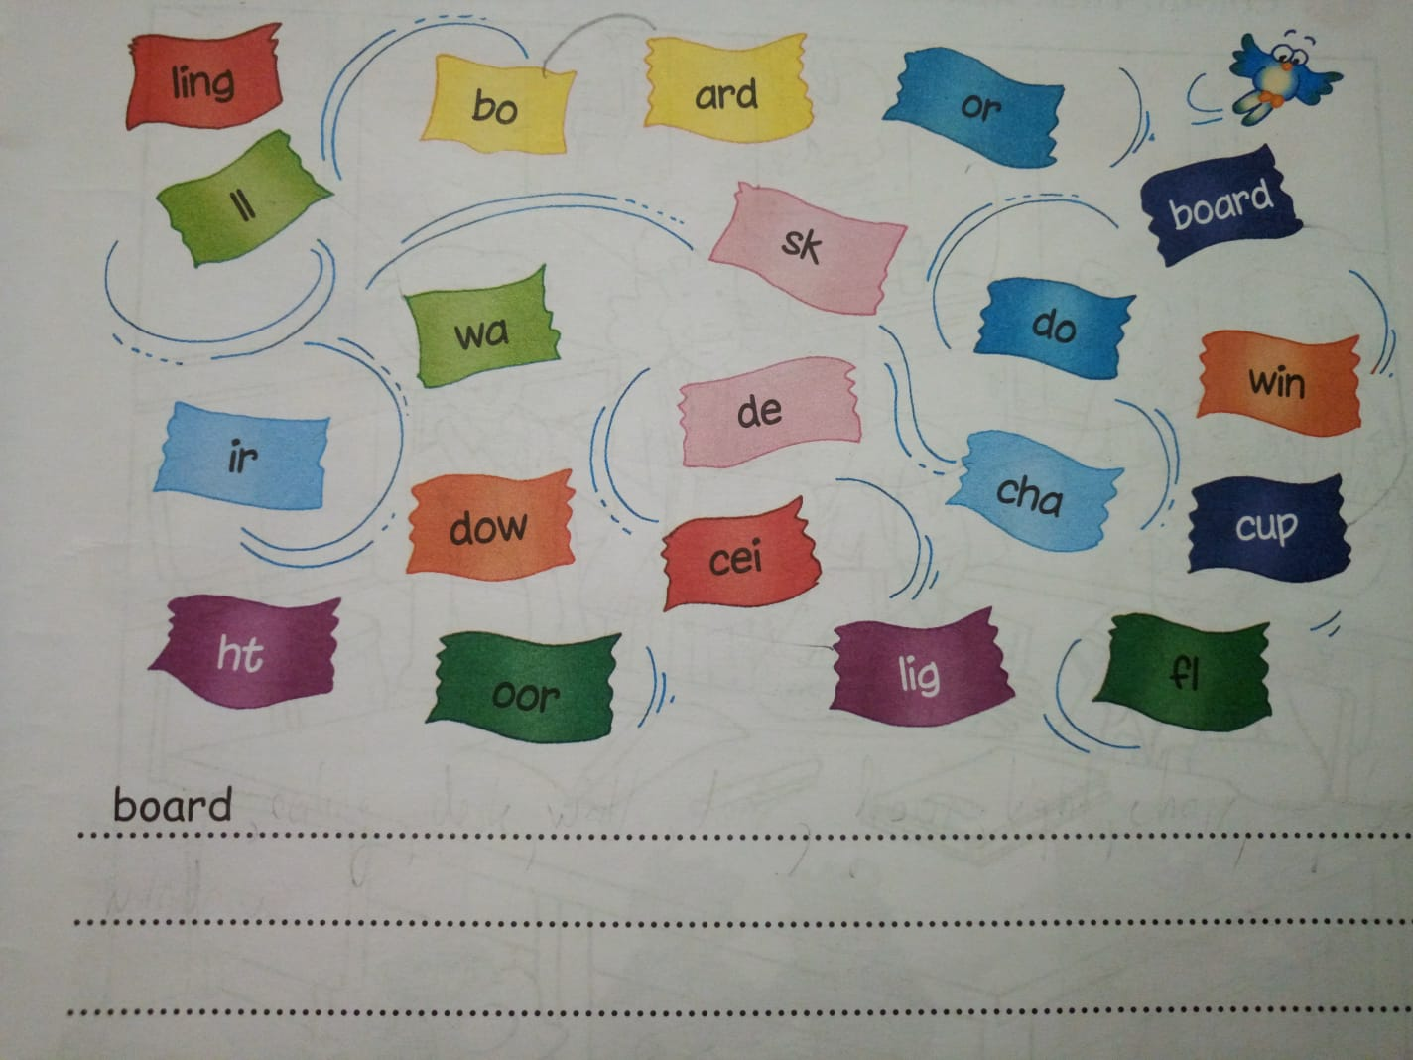
2. Match, write and translate.

Slide 4
3. Write the text.
MYNAMEISEMMAI’MEIGHTI’MIN3BMYTEACHERISMRSJOHNSON.
Ex. : My ………

